Slide 1


Slide 2

Microsoft Teams Overview
Edwardenis De Los Santos A.
Notes:
http://www.azurespeed.com/
http://portal.azure.com/
ID: Evelin.guerra@salessolvexoutlook.onmicrosoft.com
PWD: Nana0289

Slide 3
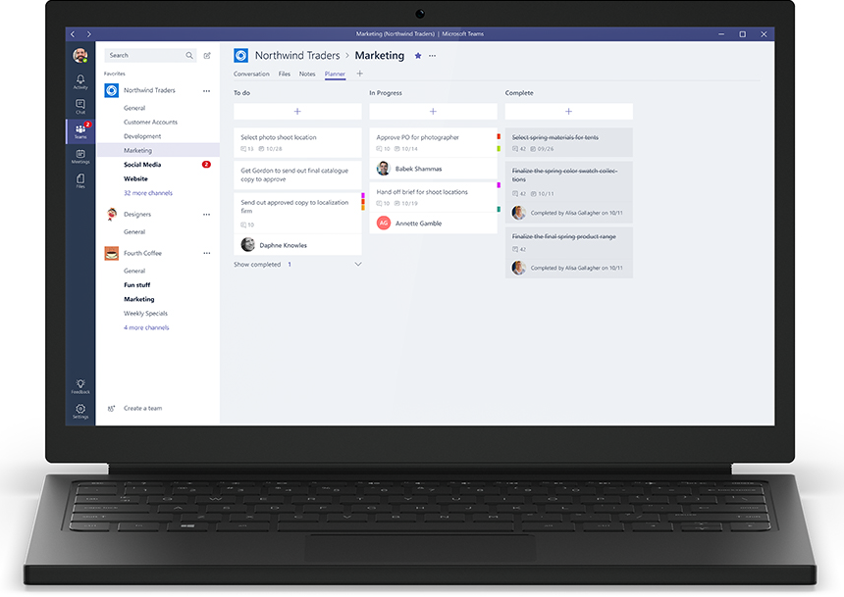

What is Teams?
New Chat-Based Workspace
Launched in Preview on Nov 2nd
Added to Office 365 subscriptions
Features
Team Channels – open conversations
1:1 Chat
Integrated Video, Meetings, Files
Desktop + Mobile Apps

Slide 4
Gracias!

